Slide 1
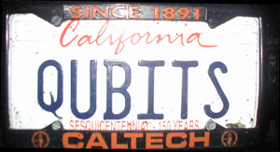
CSEP 590tv: Quantum Computing
Dave Bacon
June 29, 2005
Today’s Menu
Administrivia
Complex Numbers
Bra’s Ket’s and All That
Quantum Circuits

Slide 2
Administrivia
Changes: slowing down.
Think: Physics without Calculus
Quantum theory with a minimal of linear algebra
In class problems: hardness on the same order of magnitude
as the homework problems.
Problem Set 1: has been posted. Anyone who didn’t get my
email about the first homework being canceled, please let me
know and we will arrange accordingly.
Mailing list: sign up on sheet being passed around.
Office Hours: Ioannis Giotis, 5:30-6:30 Wednesday in 430 CSE

Slide 3
Last Week
Last week we saw that there is a big motivation for understanding
quantum computers. BIG PICTURE: understanding quantum
information processing machines is the goal of this class!
We also saw that there were there funny postulates describing quantum systems.
This week we will be slowing down and understanding the basic
workings of quantum theory by understanding one qubit and two
qubit systems.

Slide 4
Quantum Theory’s Language
“Complex linear algebra” is the language of quantum theory
Today we will go through this slowly
1. Complex numbers
2. Complex vectors
3. Bras, Kets, and all that
(in class problem)
4. Qubits
5. Measuring Qubits
6. Evolving Qubits
(in class problem)
7. Two qubits: the tensor product
8. Quantum circuits
(in class problem)

Slide 5


Math
Mathematics as a series of discoveries of objects who
at first you don’t believe exist, and then after you find
out they do exist, you discover that they are actually useful!
irrational
numbers

Slide 6








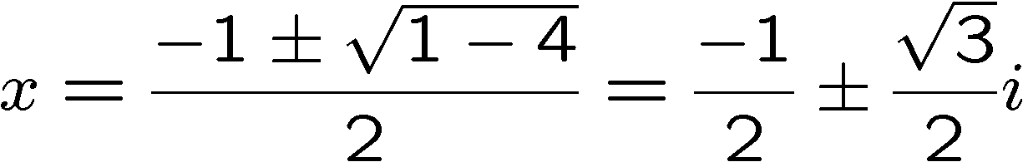
Complex Numbers, Definition
Complex numbers are numbers of the form
“square root of minus one”
real
real
Examples:
“purely real”
“purely imaginary”
roots of

Slide 7




Complex Numbers, Geometry
Complex numbers are numbers of the form
“square root of minus one”
real
real
Complex plane:
real axis
imaginary axis

Slide 8




Complex Numbers, Math
Complex numbers can be added
Example:
and multiplied
Example:

Slide 9

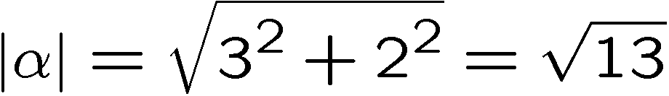
Complex Numbers, That * Thing
We can take the complex conjugate of a complex number
Example:
We can find its modulus
Example:

Slide 10
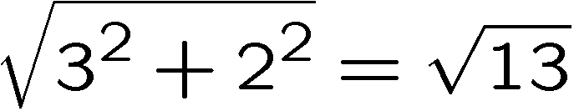
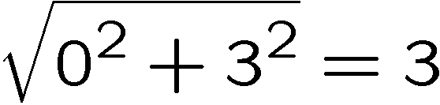
Complex Numbers, Modulus
Modulus
Modulus is the length of the complex number in the complex
plane:
real axis
imaginary axis

Slide 11
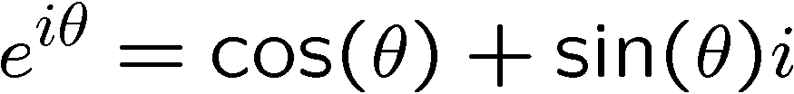
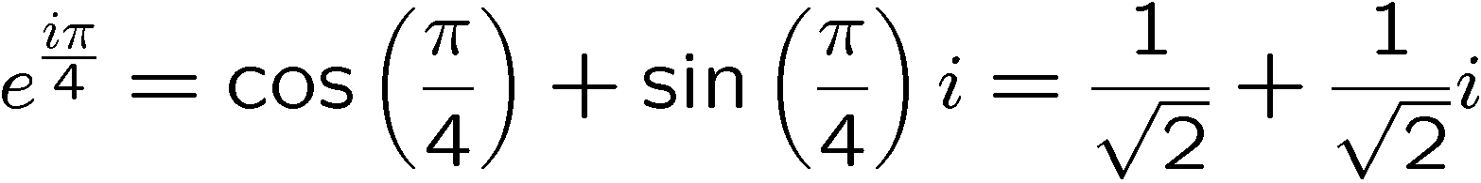
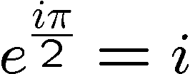


Complex Numbers, Euler
Euler’s formula
Example:
The modulus of
Some important cases:

Slide 12





Complex Numbers, Phases
Euler’s formula geometrically
real axis
phase angle
imaginary axis
Multiplying phases is beautiful:
Conjugating phases is also beautiful:

Slide 13
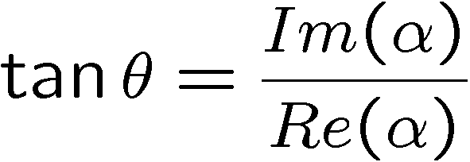





Complex Numbers, Geometry
All complex numbers can be expressed as:
real axis
modulus, magnitude
phase angle
imaginary axis

Slide 14
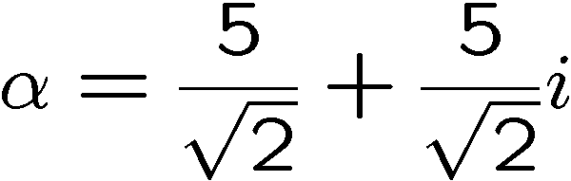
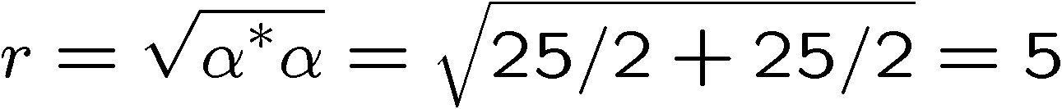
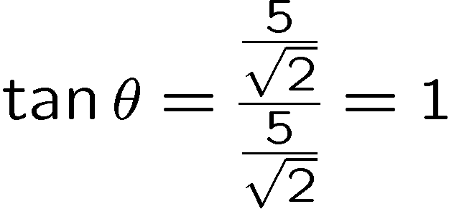
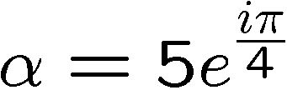
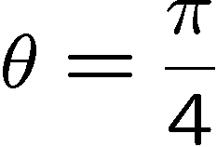
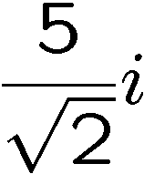
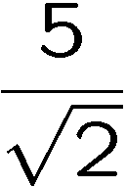
Complex Numbers, Geometry
All complex numbers can be expressed as:
Example:
real axis

Slide 15
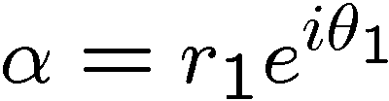
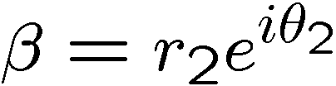
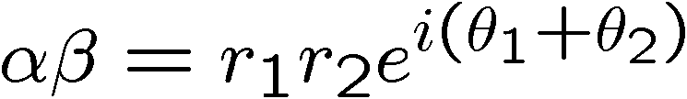
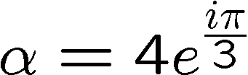
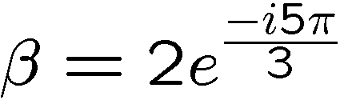
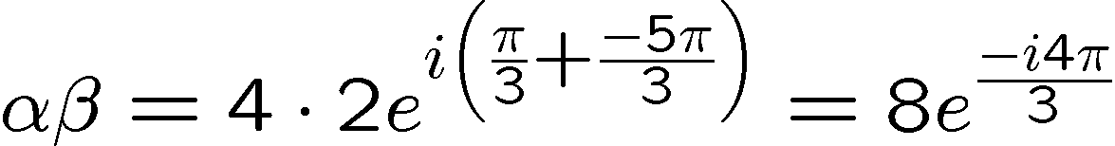
Complex Numbers, Multiplying
All complex numbers can be expressed as:
It is easy to multiply complex numbers when they are in this form
Example:

Slide 16
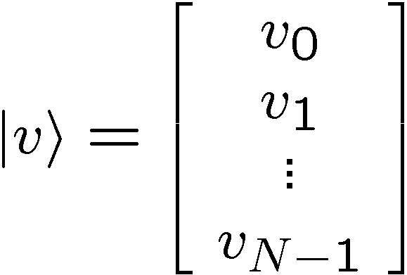

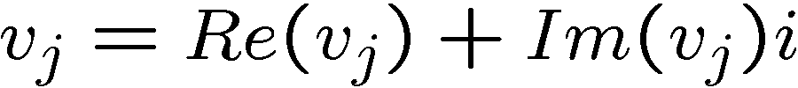
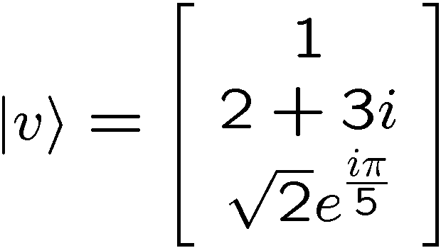
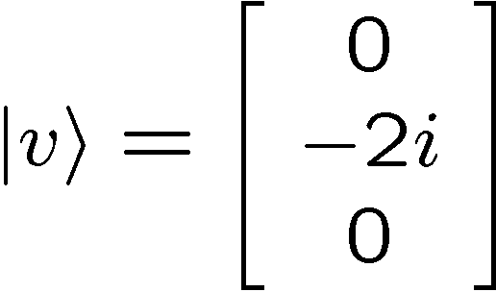
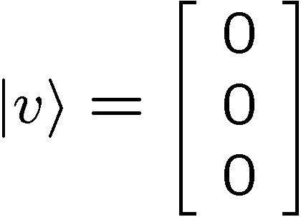
Complex Vectors
N dimensional complex vector is a list of N complex numbers:
is the th component of the vector
“ket”
“column vector”
(we start counting at 0 because eventually N will be a
a power of 2)
Example:
3 dimensional complex vectors

Slide 17
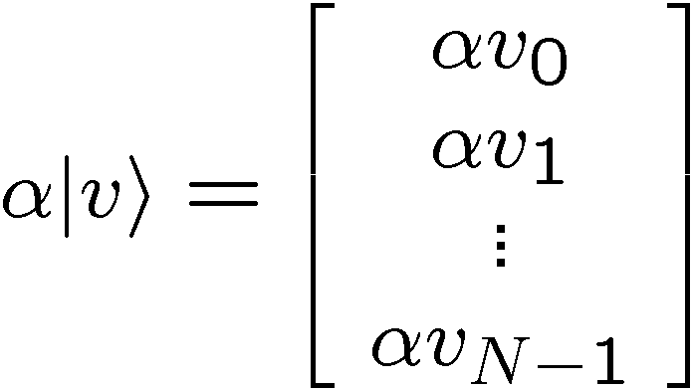

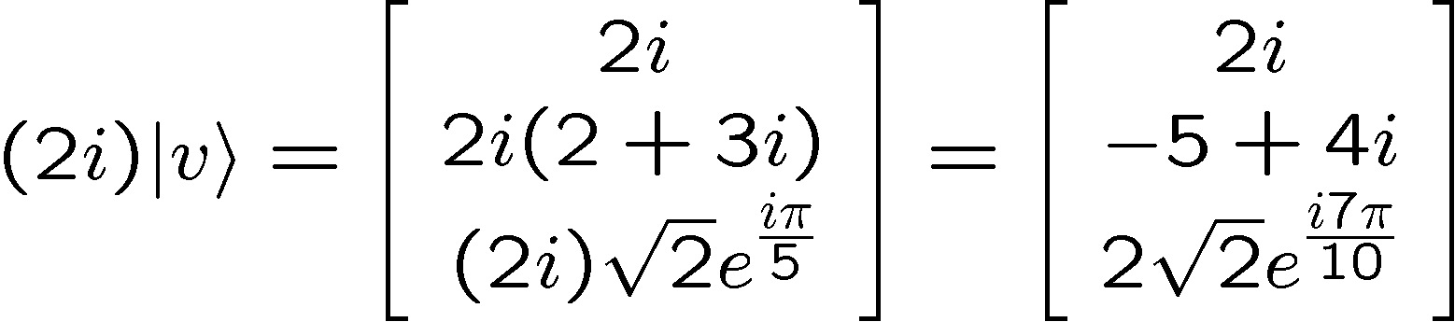
Complex Vectors, Scalar Times
Complex numbers can be multiplied by a complex number
is a complex number
Example:
3 dimensional complex vector multiplied by a complex number

Slide 18
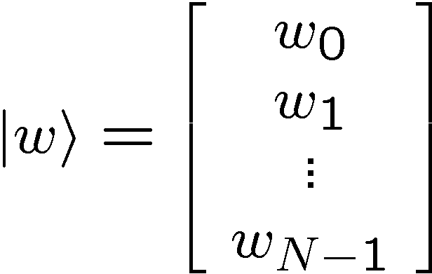
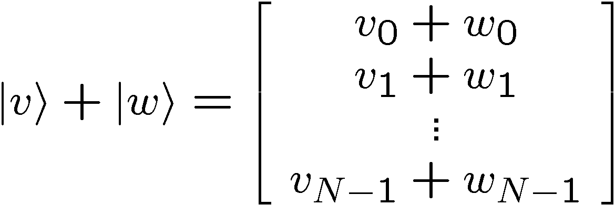
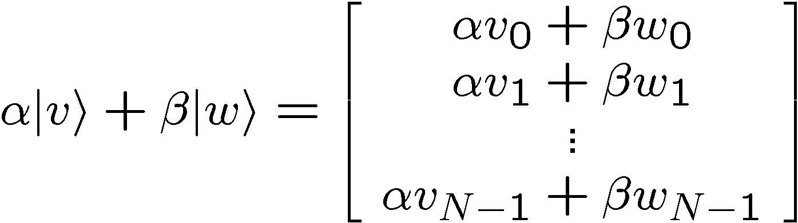
Complex Vectors, Addition
Complex numbers can be added
Addition and multiplication by a scalar:

Slide 19
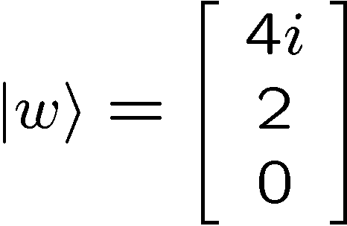
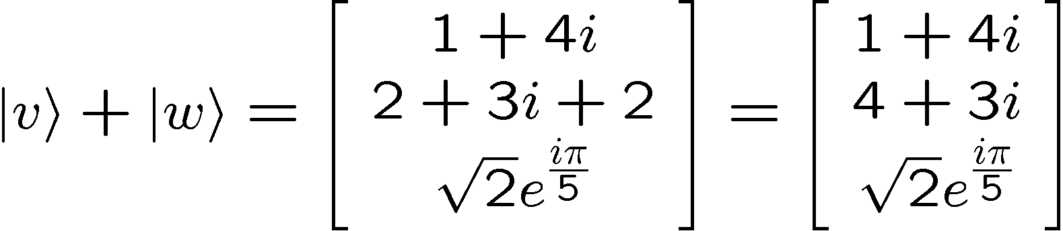
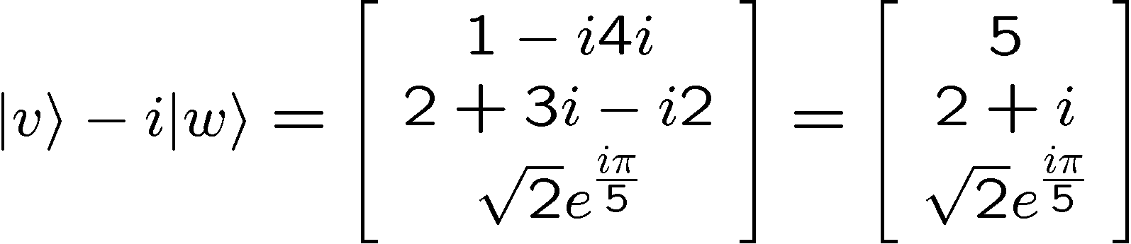
Complex Vectors, Addition
Examples:

Slide 20



Vectors, Addition
Remember adding real vectors looks geometrically like:
We should have a similar picture in mind for complex vectors
But the components of our vector are now complex numbers

Slide 21
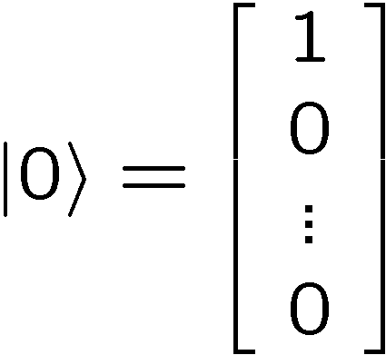
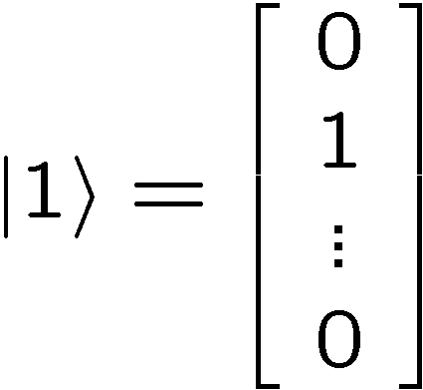
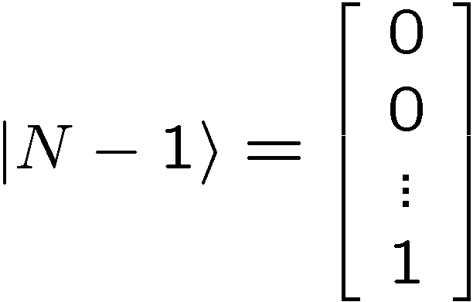
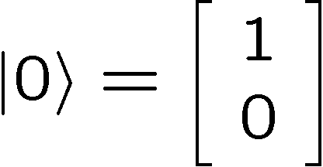
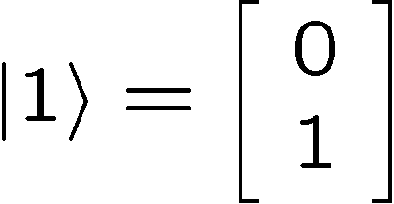
Computational Basis
Some special vectors:
Example:
2 dimensional complex vectors (also known as: a qubit!)

Slide 22
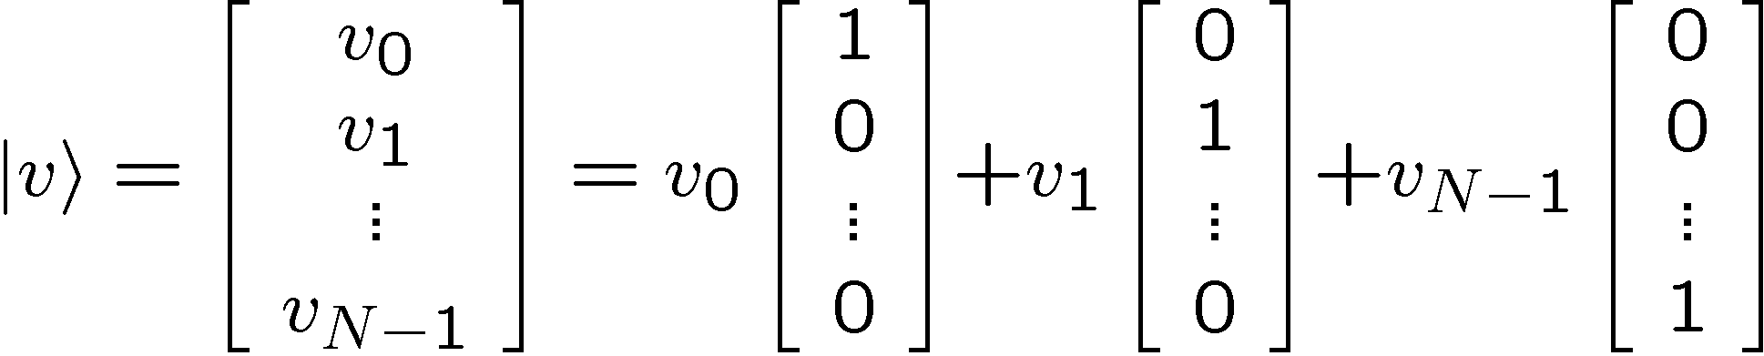
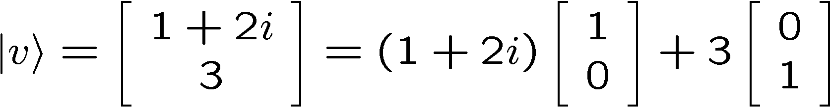

Computational Basis
Vectors can be “expanded” in the computational basis:
Example:

Slide 23



Computational Basis Math
Example:

Slide 24

Computational Basis Math
Example:

Slide 25
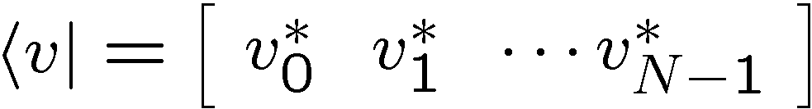
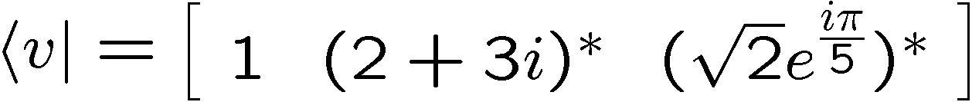
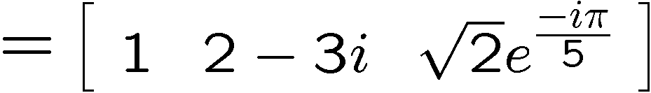
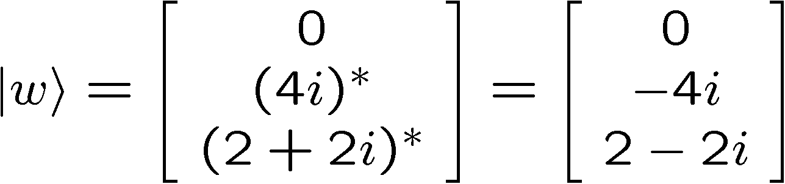
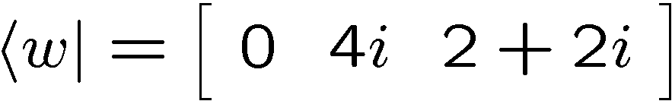
Bras and Kets
For every “ket,” there is a corresponding “bra” & vice versa
Examples:

Slide 26
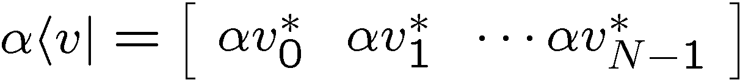
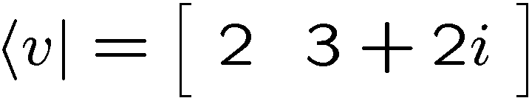
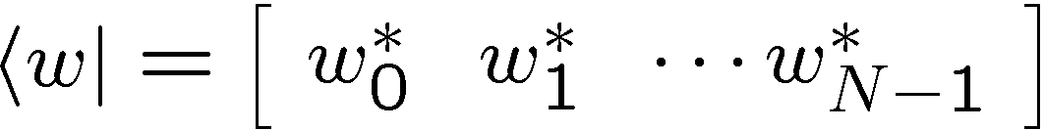

Bras, Math
Multiplied by complex number
Example:
Added
Example:

Slide 27



Computational Bras
Computational Basis, but now for bras:
Example:

Slide 28

The Inner Product
Given a “bra” and a “ket” we can calculate an “inner product”
This is a generalization of the dot product for real vectors
The result of taking an inner product is a complex number

Slide 29





The Inner Product
Example:
Complex conjugate of inner product:

Slide 30



The Inner Product in Comp. Basis
Inner product of computational basis elements:
Kronecker delta

Slide 31


The Inner Product in Comp. Basis
Example:

Slide 32
In Class Problem # 1

Slide 33



Norm of a Vector
Norm of a vector:
which is always a positive real number
it is (roughly) the length of the complex vector
Example:

Slide 34



Quantum Rule 1
Rule 1: The wave function of a N dimensional quantum system
is given by an N dimensional complex vector with norm equal
to one.
Example:
a valid wave function for a 3 dimensional quantum system

Slide 35








Qubits
Two dimensional quantum systems are called qubits
A qubit has a wave function which we write as
Examples:
Valid qubit wave functions:
Invalid qubit wave function:

Slide 36


Measuring Qubits
A bit is a classical system with two possible states, 0 and 1
A qubit is a quantum system with two possible states, 0 and 1
When we observe a qubit, we get the result 0 or the result 1
0
or
1
If before we observe the qubit the wave function of the qubit is
then the probability that we observe 0 is
and the probability that we observe 1 is
“measuring in the computational basis”

Slide 37




Measuring Qubits
Example:
We are given a qubit with wave function
If we observe the system in the computational basis, then we
get outcome 0 with probability
and we get outcome 1 with probability:

Slide 38


Measuring Qubits Continued
When we observe a qubit, we get the result 0 or the result 1
0
or
1
If before we observe the qubit the wave function of the qubit is
then the probability that we observe 0 is
and the probability that we observe 1 is
and the new wave function for the qubit is
and the new wave function for the qubit is
“measuring in the computational basis”

Slide 39

Measuring Qubits Continued
new wave function
probability
0
probability
new wave function
1
The wave function is a description of our system.
When we measure the system we find the system in one state
This happens with probabilities we get from our description

Slide 40

Measuring Qubits
Example:
We are given a qubit with wave function
If we observe the system in the computational basis, then we
get outcome 0 with probability
new wave function
and we get outcome 1 with probability:
new wave function

Slide 41


Measuring Qubits
Example:
We are given a qubit with wave function
If we observe the system in the computational basis, then we
get outcome 0 with probability
new wave function
and we get outcome 1 with probability:
a.k.a never

Slide 42






Quantum Rule 3
Rule 3: If we measure a N dimensional quantum system with
the wave function
in the basis, then the probability of
observing the system in the state is . After such a
measurement, the wave function of the system is
probability
new wave function
0
probability
new wave function
1
probability
new wave function
N-1

Slide 43





Matrices
A N dimensional complex matrix M is an N by N array
of complex numbers:
are complex numbers
Example:
Three dimensional complex matrix:

Slide 44




Matrices, Multiplied by Scalar
Matrices can be multiplied by a complex number
Example:

Slide 45




Matrices, Added
Matrices can be added
Example:

Slide 46


Matrices, Multiplied
Matrices can be multiplied

Slide 47





Matrices, Multiplied
Example:
Note:

Slide 48


Matrices and Kets, Multiplied
Given a matrix, and a column vector:
These can be multiplied to obtain a new column vector:

Slide 49



Matrices and Kets, Multiplied
Example:

Slide 50


Matrices and Bras, Multiplied
Given a matrix, and a row vector:
These can be multiplied to obtain a new row vector:

Slide 51



Matrices and Bras, Multiplied
Example:

Slide 52


Matrices, Complex Conjugate
Given a matrix, we can form its complex conjugate by
conjugating every element:
Example:

Slide 53


Matrices, Transpose
Given a matrix, we can form it’s transpose by reflecting across
the diagonal
Example:

Slide 54


Matrices, Conjugate Transpose
Given a matrix, we can form its conjugate transpose by
reflecting across the diagonal and conjugating
Example:

Slide 55


Bras, Kets, Conjugate Transpose
Taking the conjugate transpose of a ket
gives the corresponding bra:
Similarly we can take the conjugate transpose of a bra to get
the corresponding ket:

Slide 56




Unitary Matrices
A matrix is unitary if
N x N identity
matrix
Equivalently a matrix is unitary if

Slide 57






Unitary Example
Conjugate:
Conjugate
transpose:
Unitary?
Yes:

Slide 58

Quantum Rule 2
Rule 2: The wave function of a N dimensional quantum system
evolves in time according to a unitary matrix . If the wave
function initially is then after the evolution correspond to
the new wave function is
“Unitary Evolution”

Slide 59




Unitary Evolution and the Norm
Unitary evolution
What happens to the norm of the ket?
Unitary evolution does not change the length of the ket.
Normalized wave function
Normalized wave function
unitary evolution

Slide 60



Unitary Evolution for Qubits
Unitary evolution will be described by a two dimensional
unitary matrix
If initial qubit wave function is
Then this evolves to

Slide 61




Unitary Evolution for Qubits

Slide 62


Single Qubit Quantum Circuits
Circuit diagrams for evolving qubits
quantum gate
input
qubit
wave
function
output
qubit
wave
function
quantum wire
single line = qubit
time

Slide 63





Single Qubit Quantum Circuits
Two unitary evolutions:
measurement in the basis
Probability of outcome 0:
Probability of outcome 1:

Slide 64
In Class Problem #2

